Slide 1

SHAUUUUUUUUUN Progress Report 3 Gravity Xscape
John Frazia, Matthew Nagy, and Oliver Rayner

Slide 2
General Summary
Done
Fixed player gravity and environment collisions.
Finished game level outline.
Music research.
To Do
Implement the animation actions within the Unity Animator.
Compose the music.

Slide 3

Detailed Summary (John)
Music research.
Currently know the experience goal of the music.
Messed around with various music software, chose Musescore3.
Worked on more sound effects.

Slide 4
Detailed Summary (Matt)
Player gravity shift.
Fixed the wall collision.
Player and ground bug fixes.

Slide 5
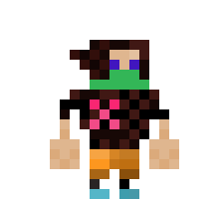
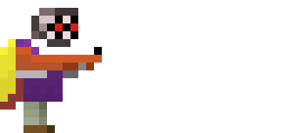

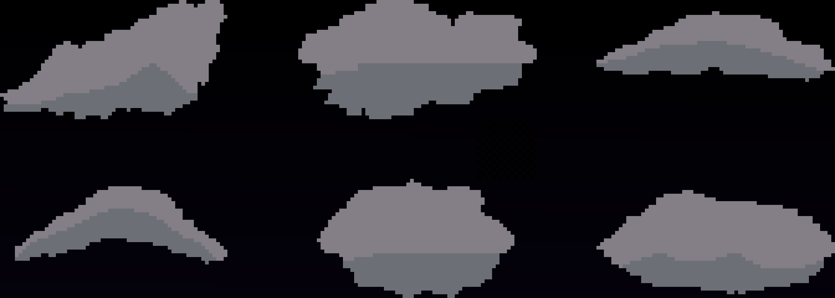
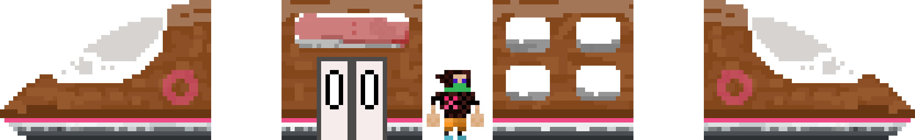
Detailed Summary (Oliver)
Made Animations for characters and objects (Implemented in Unity).
Prototypes of the three levels have colliding environments (Done in Tiled).
Made background and sky clouds (Implemented in Unity and Tiled).

Slide 6
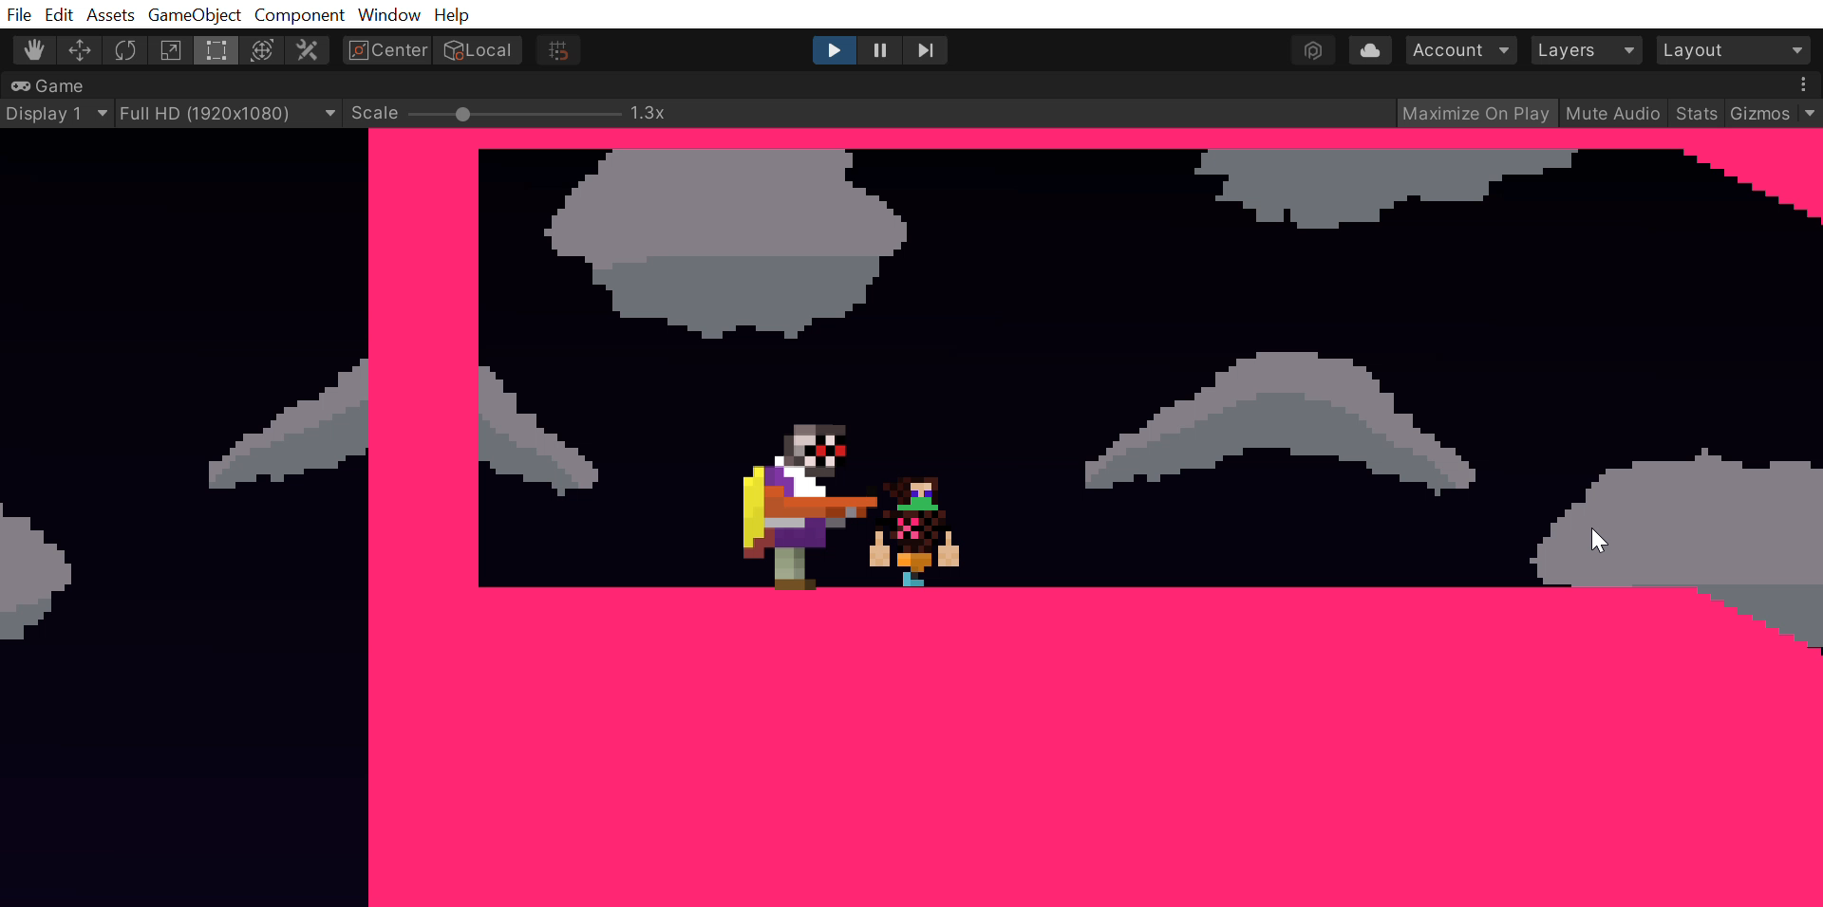
Quick Demo

Slide 7
Triumphs & Setbacks
Triumph:
-We finalized the game outline.
-Established the ending of the game.
-We have a character moving in the scenes.
-Using Tiled has made development on the levels faster.
Setback:
-Focused too much on music, went into sound effect time.
-Bugs are taking more time than anticipated.

Slide 8
Honest Assessment
We are minorly behind schedule.
Work more on sound effects.
Pitch in to get more of the code done.

